Slide 1


Project Presentation

Slide 2

Office Collaborator

Slide 3
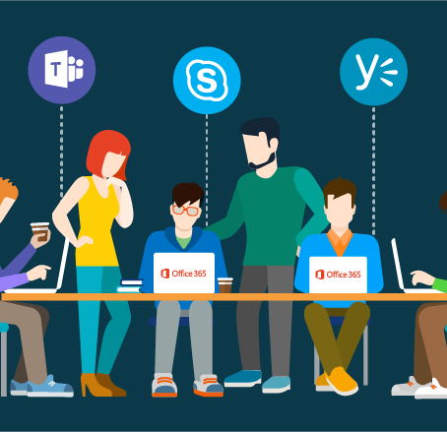
INTRODUCTION
We are going to present our project Office Collaborator that is a managerial website. This presentation gives an overall description of a project.
In this presentation overview, we are going to tell you a complete detailing of a project like the idea behind the project and all the implementation that will be done by group members of a project.
All the implementation, designing, and execution of a project done by Vishal Singh with my team members Uddeshya Sharma ,Anubhav Maurya, Vaibhav Srivastava under the guidance of Mr. Ankit Verma

Slide 4


WHY DO WE NEED THIS SYSTEM ?
TO FACILITATES COMMUNICATION
TO COORDINATE DISPERSE WORK
TO MANAGE THE DATA IN A CENTRALISIZED MANNER

Slide 5

SCOPE OF THE PROJECT
CAN BE USED AS A TO DO APP
BETTER PROBLEM SOLVING
BREAK DOWN BARRIES
FASTER PRODUCTION

Slide 6

FEATURES OF THE PROJECT
FAST PERFORMANCE
RELIABLE PERFORMANCE
REMOTE LOGIN
MINIMISE POTENTIAL HUMAN ERRORS
EASY ACCESS TO THE DAY TO DAY ACTIVITIES
EFFICIENT EMPLOYEES CAN BE IDENTIFIED EASILY
INCREASE COMPETITIVE ADVANTAGE

Slide 7




TECHNOLOGY USED
xampp
php
My Sql
HTML & CSS

Slide 8
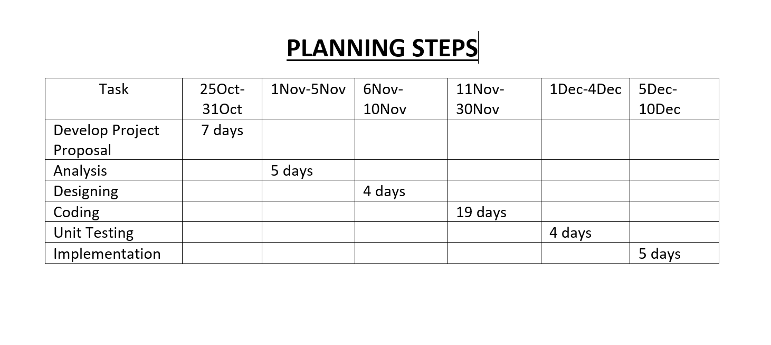

PLANNING STEP

Slide 9
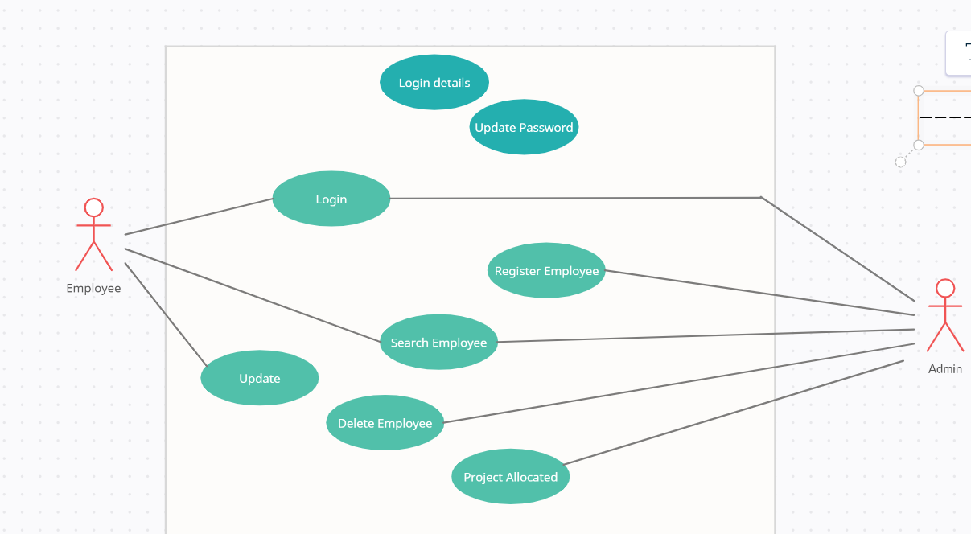
USE CASE
includes
includes
includes
includes
includes
includes
includes

Slide 10
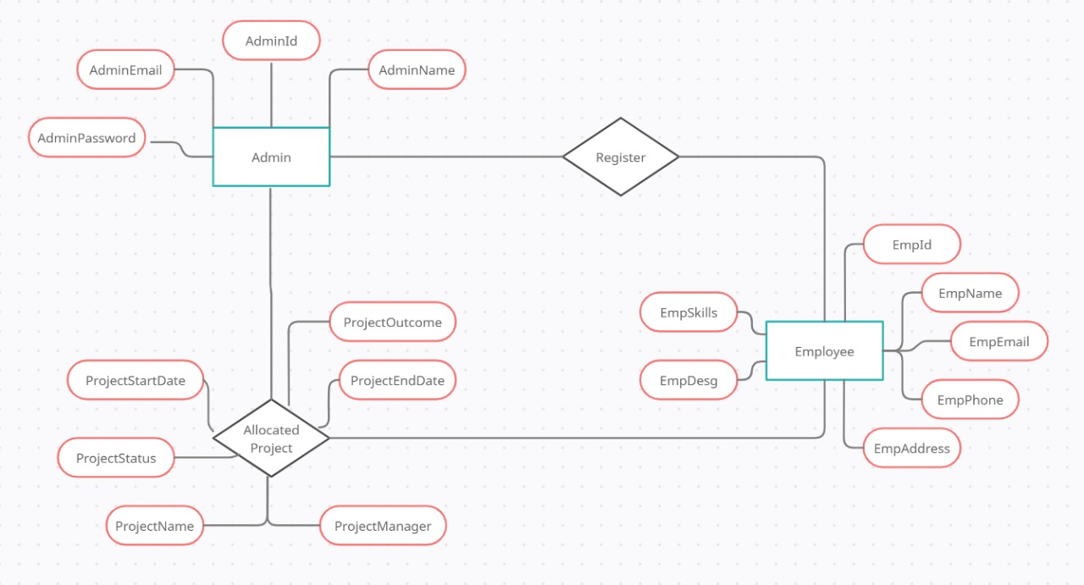
Entity Relationship Diagram

Slide 11
Zero Level DFD
Office Collaborator
Admin
Employee

Slide 12
Level-One DFD For Admin
Search Employee
Report employee
Response from DB
Search
Add
Employee
Request to DB
Employee List
Add
ADMIN
Project Report
Project Allocated
Response from DB
Request to DB
List of Project
Delete
Delete Employee
Report
Response from DB
Request to DB
Status: Inactive/Active

Slide 13
Level-One DFD For Employee
Search his/her companion
Information of searched employee
Search
Address
Update
Mobile Number
EMPLOYEE
Profile Request
Password
Password
Skills
Project Name
View
Project Allocated
Project Manager
All his project Allocated

Slide 14
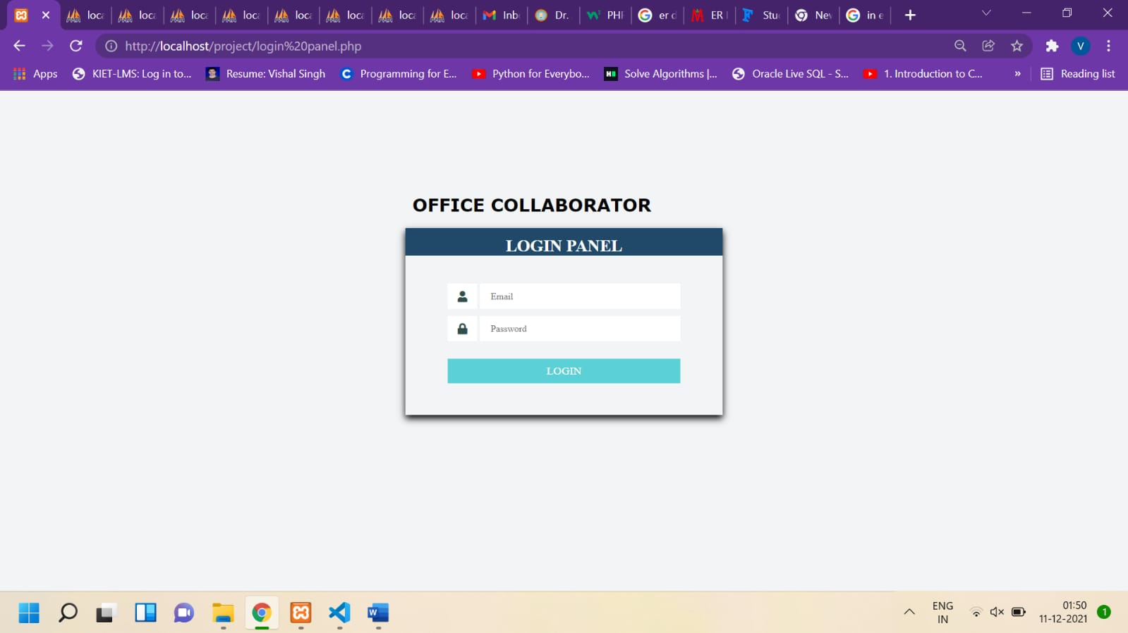
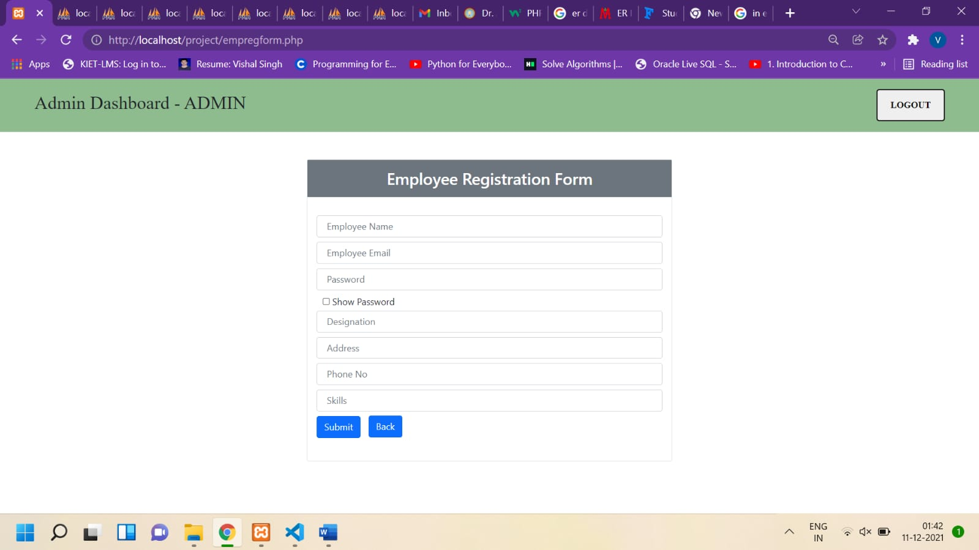
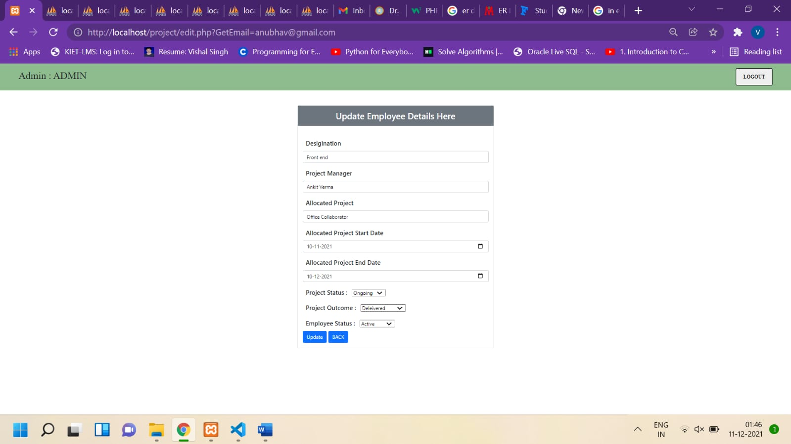
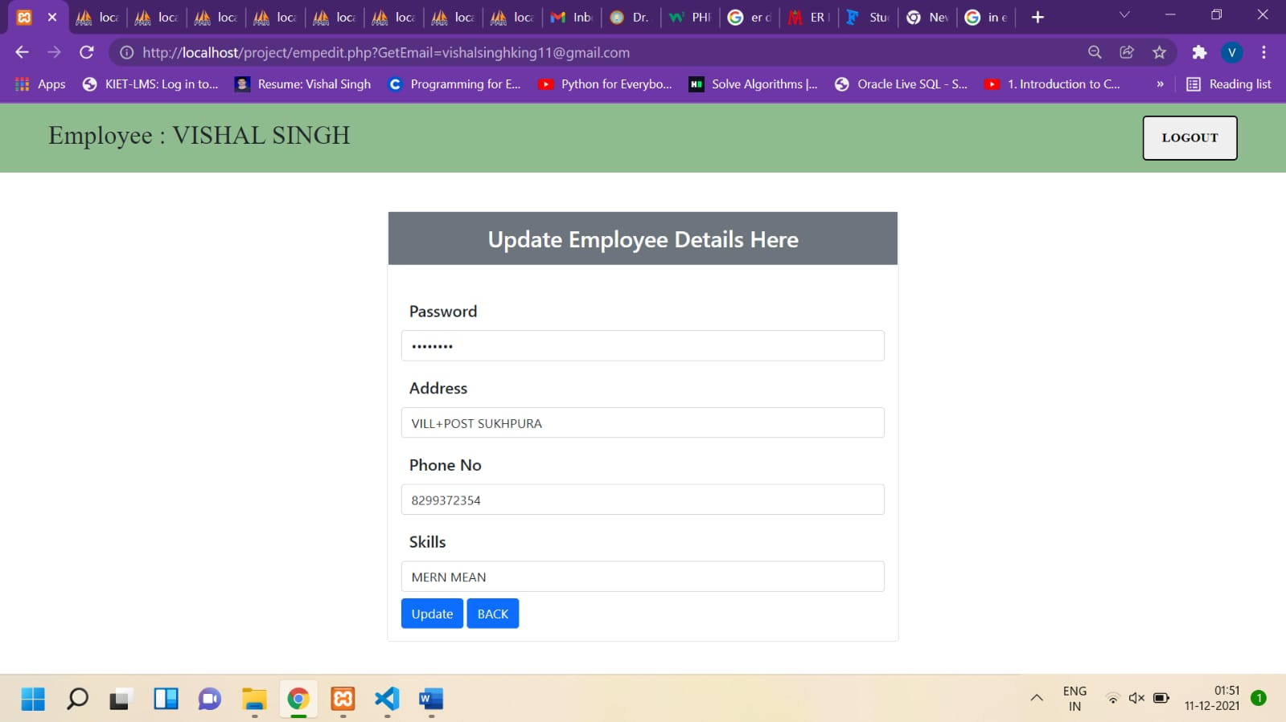
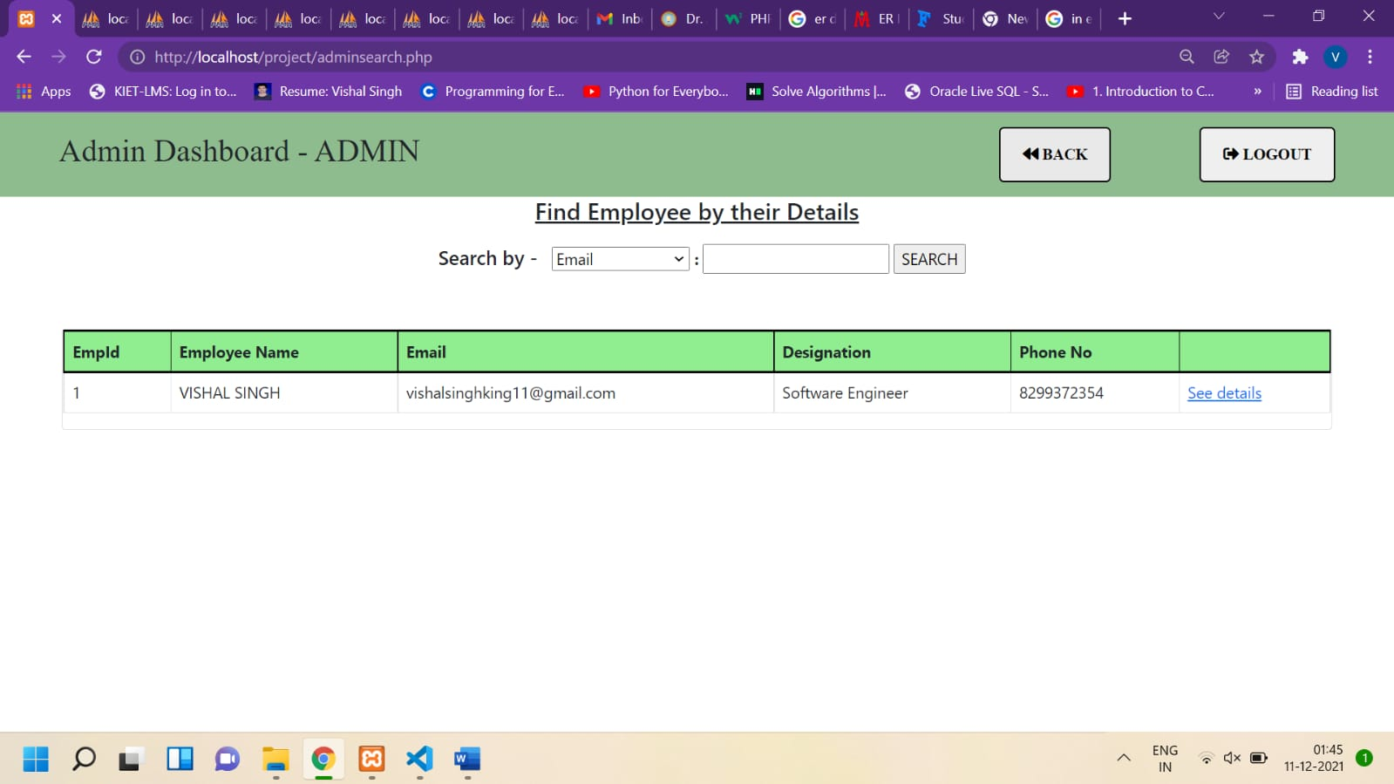
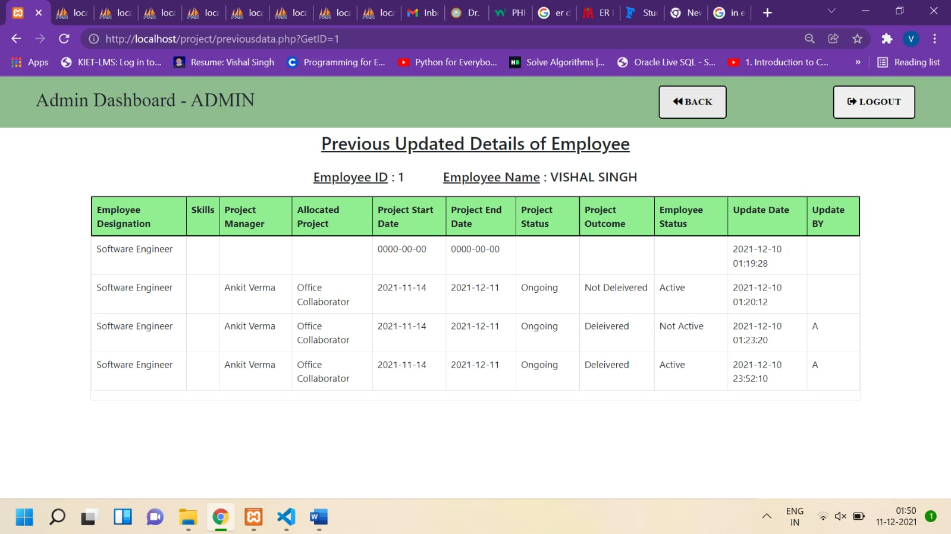
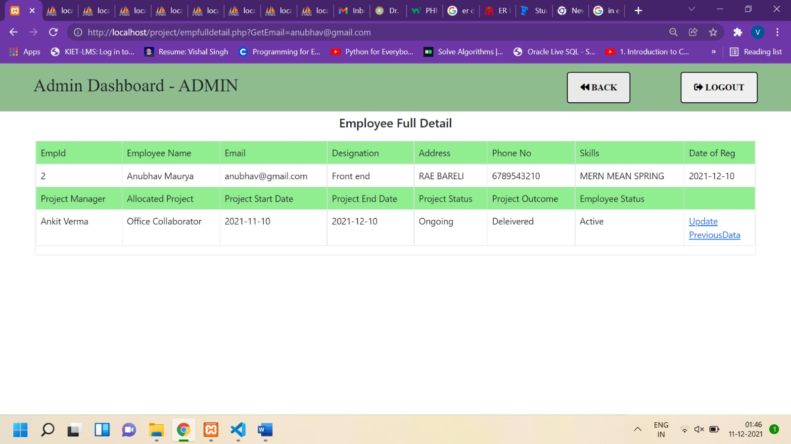
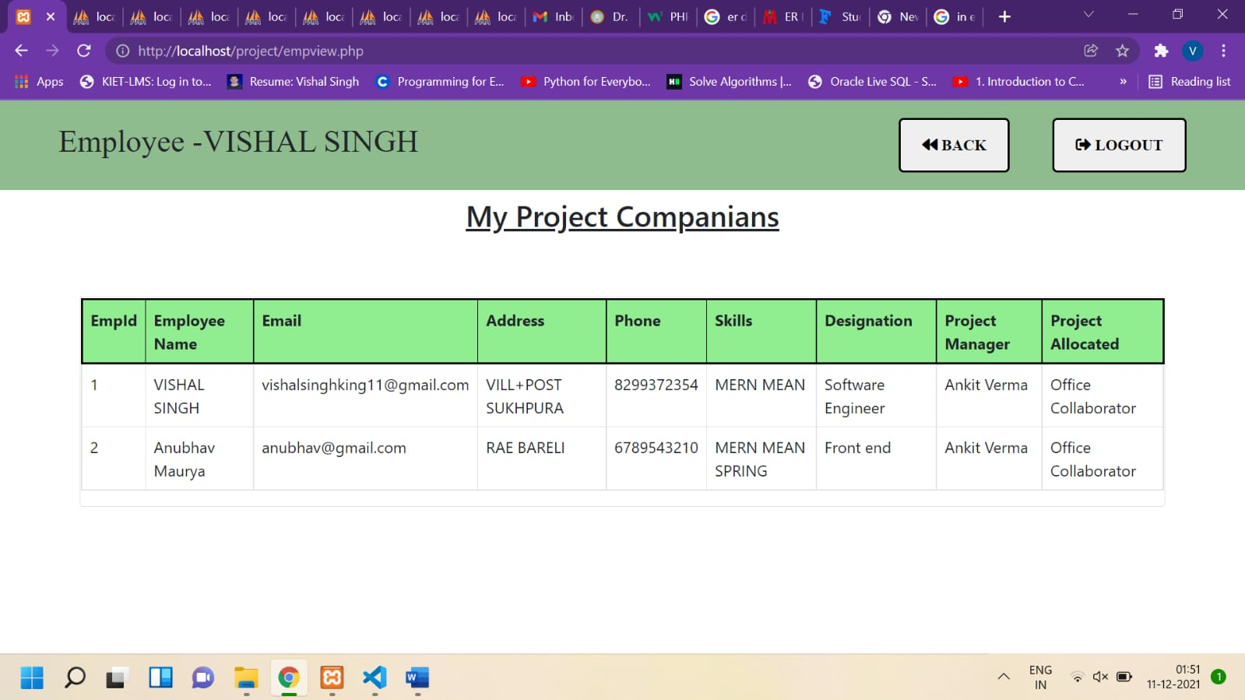
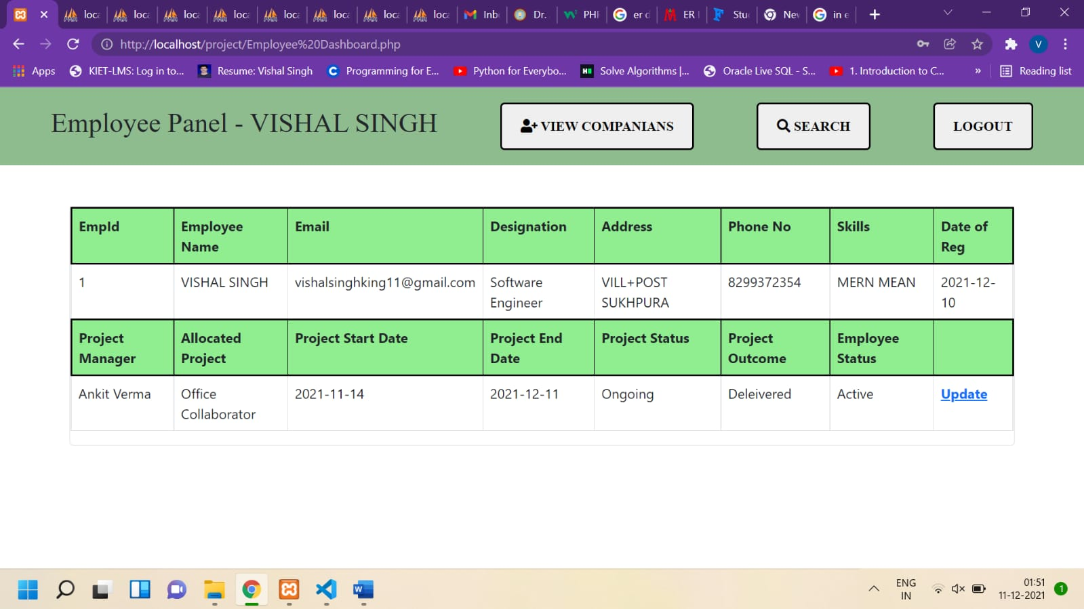
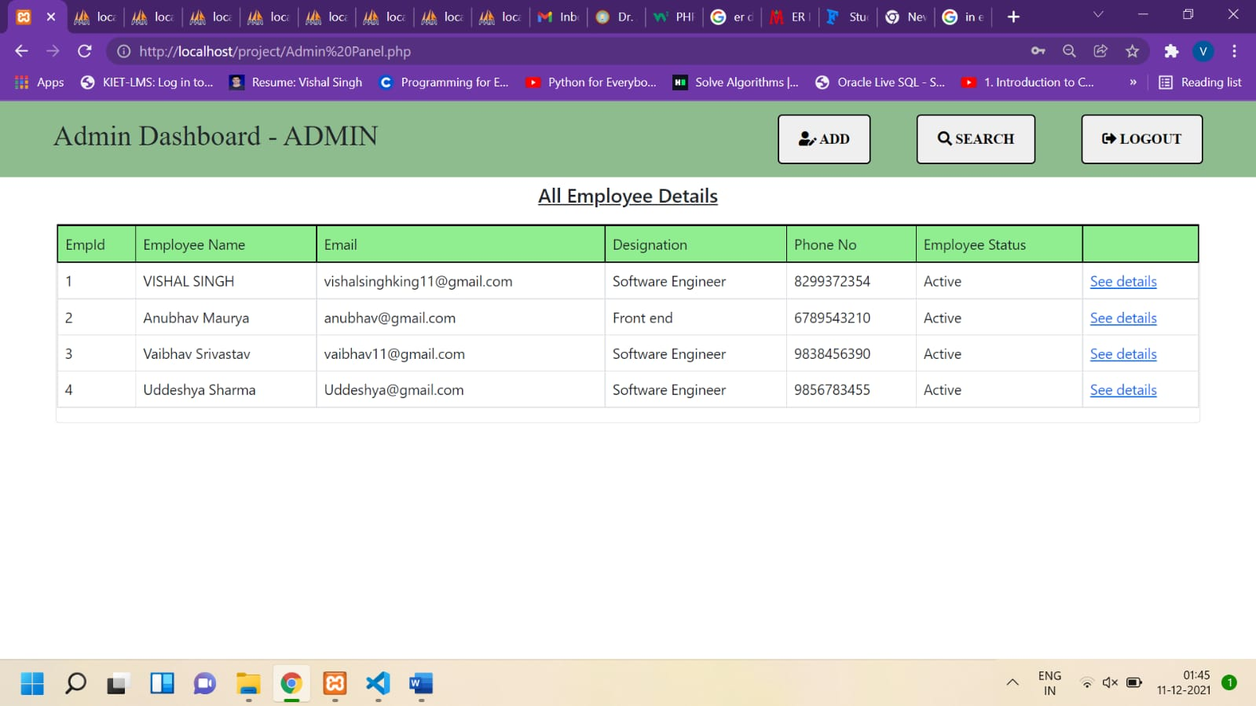

Slide 15


DO YOU HAVE ANY QUESTION ? PLEASE ASK AND GIVE THE FEEDBACK

